Slide 1

VIRTUAL KEYBOARD
Mentor :- Prof. Pritam Warke
C21084 :- Mayur Patil
C21101 :- Siddhi Rane

Slide 2
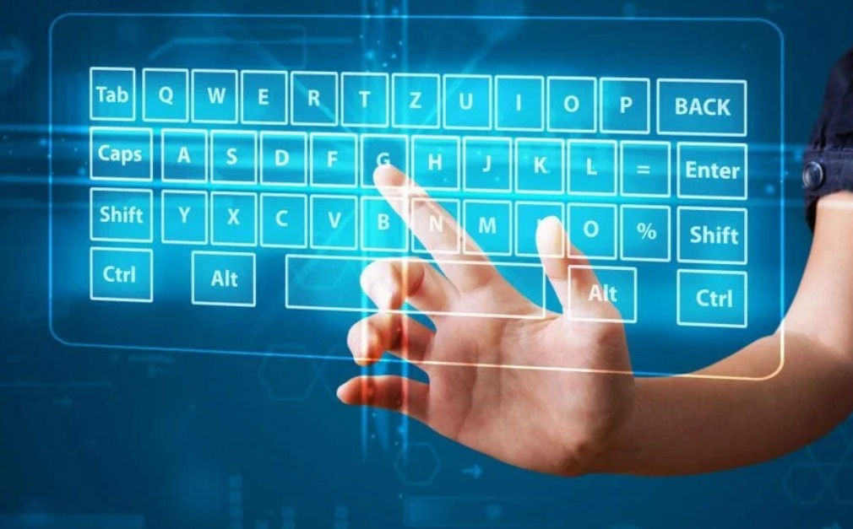
Introduction
A virtual keyboard is a software component that allows the input of characters without the need for physical keys.

Slide 3
Requirement Specification
Technology:​
Python ​
Software Used:​
Pycharm

Slide 4
Idea Behind The Project
A virtual keyboard can be used to emulate a standard keyboard.
Virtual keyboards can allow the computer use by people with significant mobility impairments.
It can also incorporate word prediction to increase entry speed.

Slide 5
Approches
OpenCV is the most popular library for the task of computer vision.
CVzone is a computer vision package, where it uses OpenCV and MediaPipe librariesas its core that makes us easy to run like hand tracking, face detection.

Slide 6
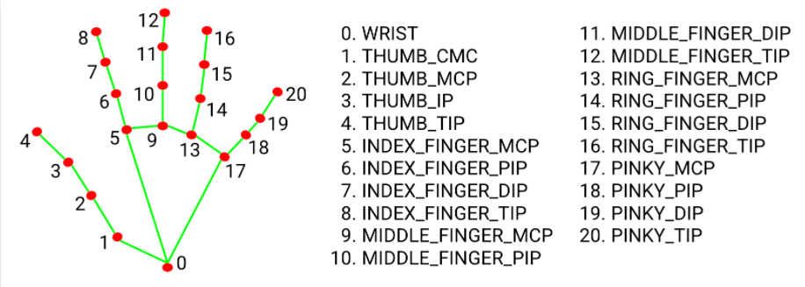
Hand Landmark Model

Slide 7
Library
OpenCV is a very famous library for computer vision and image processing tasks.​
Pynput-The pynput library allows you to control and monitor/listen to your input devices such as the keyboard and mouse.​
MediaPipe - MediaPipe has supercharged our work on vision and hearing features , allowing us to bring features like Quick Gestures .

Slide 8
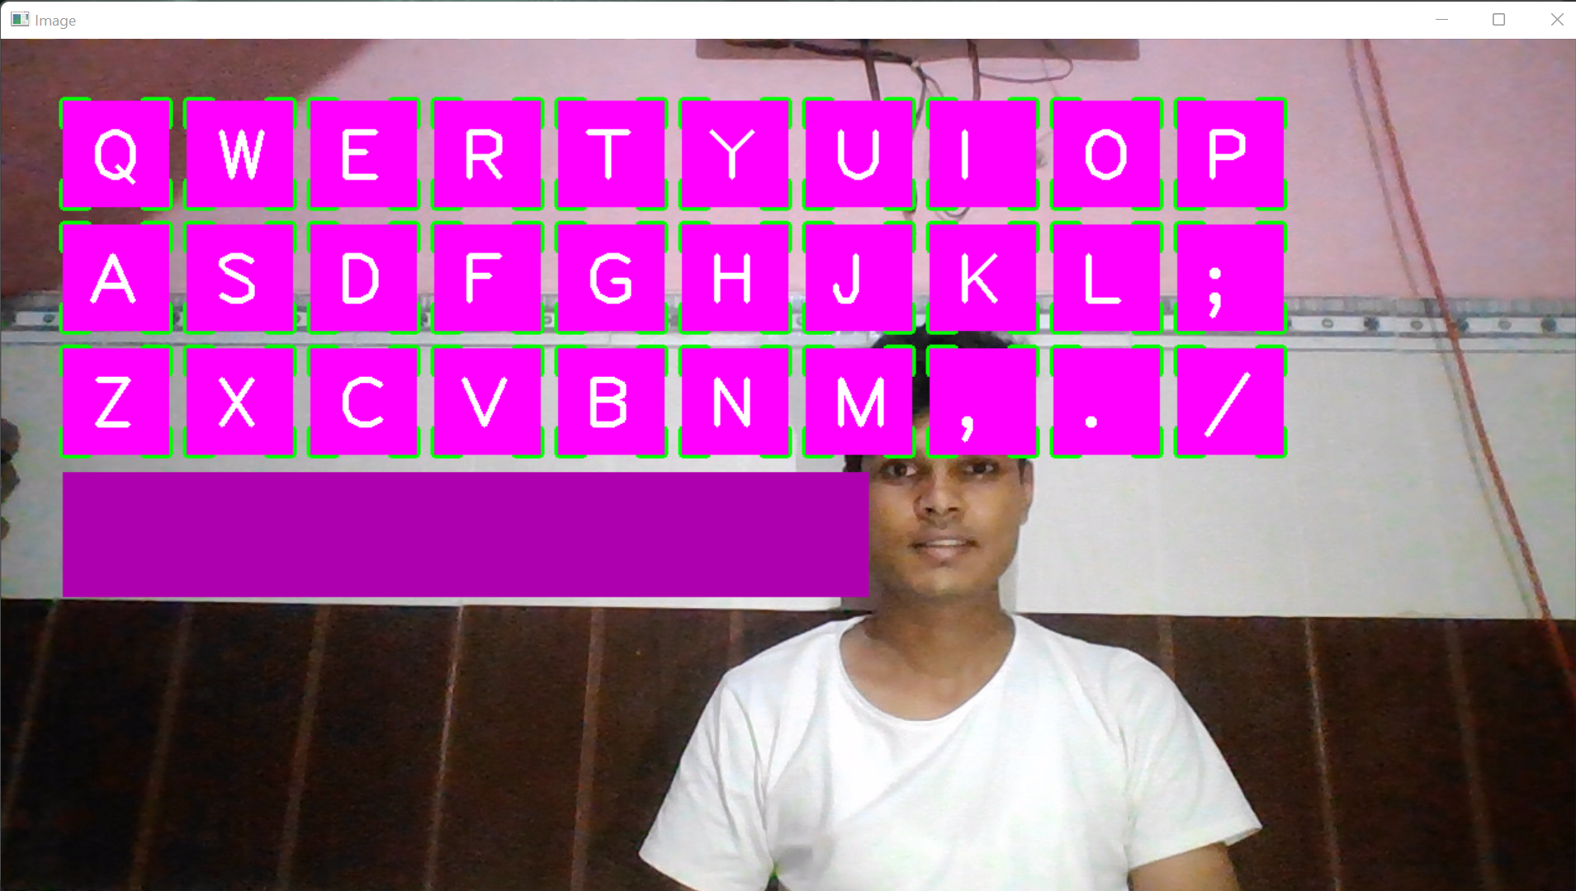
Virtual keyboard

Slide 9
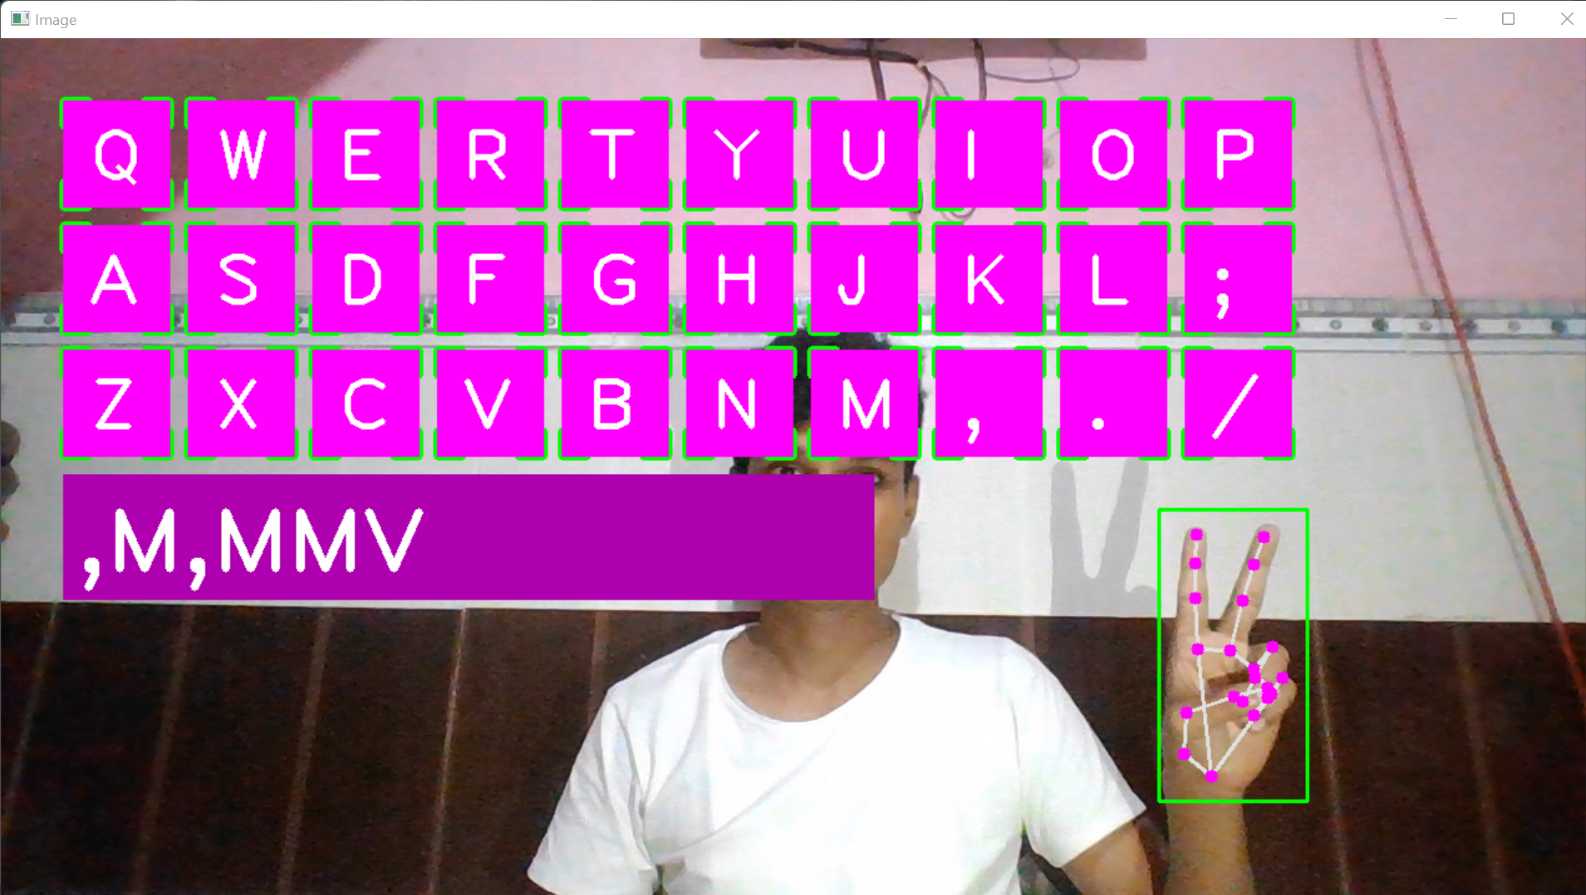
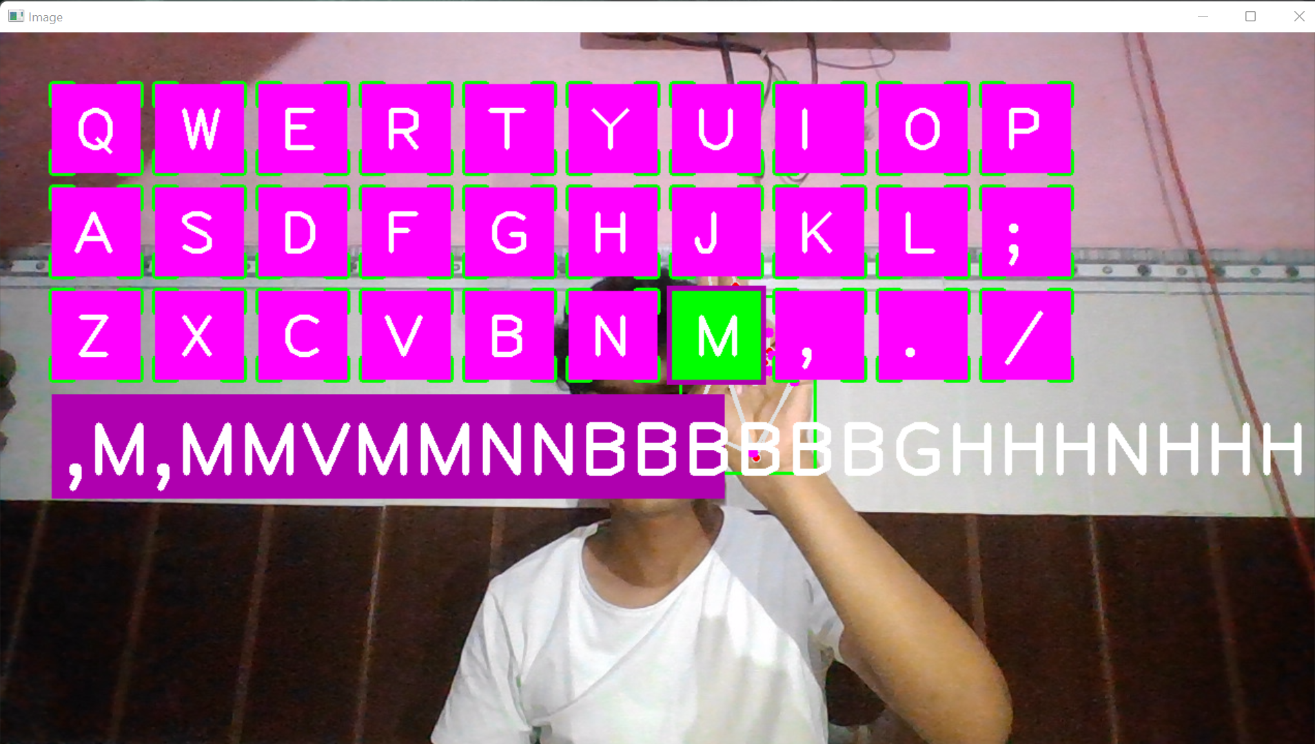
Virtual keyboard

Slide 10
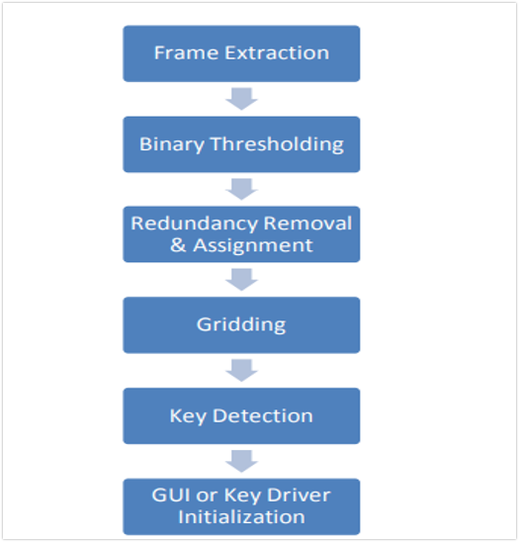
UML Diagram

Slide 11
Future Scope
The basic idea of building a virtual keyboard can be expanded upon to build an even better and more userfriendly gadget. ​
Increase in Speed​
Multi-touch compatibility:​
Android compatibility:​

Slide 12
Conclusion
The virtual keyboard concept demonstrated in our project is not only technically feasible, but also has enormous market potential. As our aim for building the gadget was only to test its technical feasibility, there are some drawbacks to the device which need to be overcome before its true potential can be realized.​

Slide 13
Thank you

